Slide 1


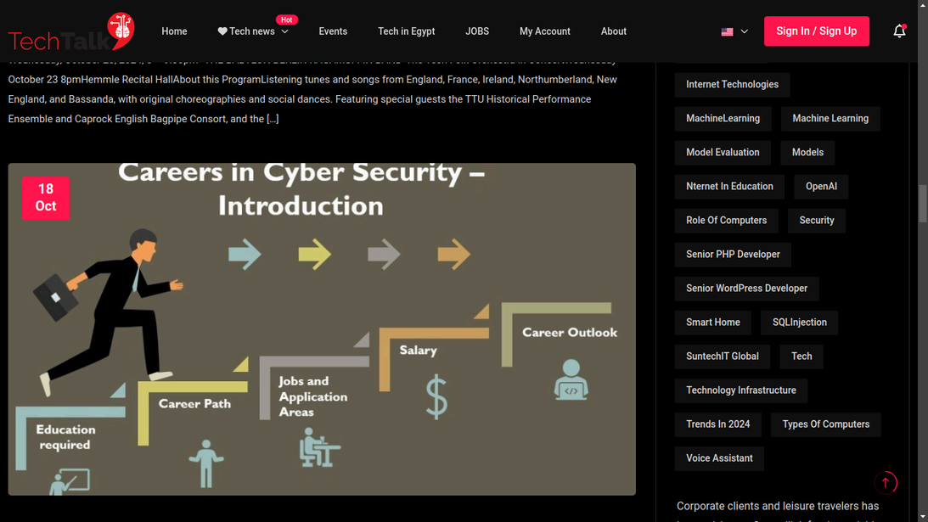
Tech-Talk
Home
Problem
Features
Tech Aspects
Dev Process
TECH-TALKS
PRESENTATION
Blog & News website using WP
Start Page
>

Slide 2
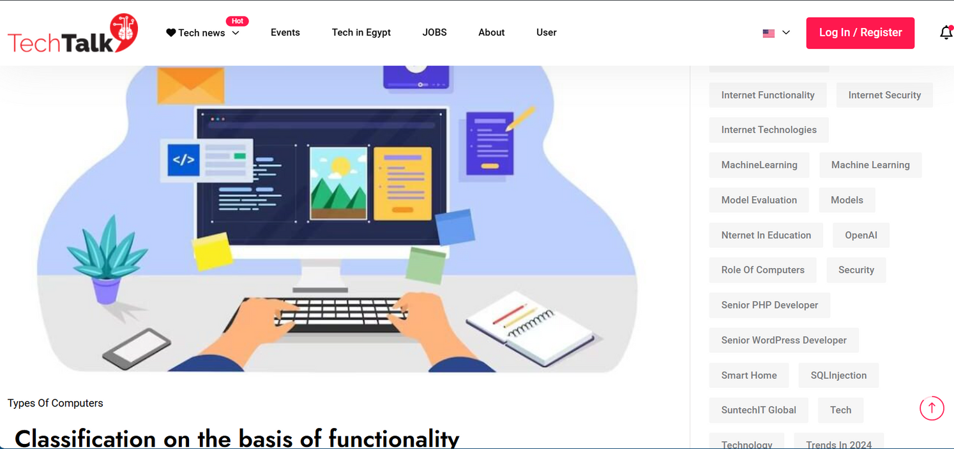
Tech-Talk
Home
Problem
Features
Tech Aspects
Dev Process
INRTODUCTION
Tech Talks is A Platform for Tech News and Community Engagement .
Objective of Tech Talks is designed to be a go-to platform for tech enthusiasts to read the latest news, learn about trending topics, and engage with a community through comments.
Tech-Talk.site
Target Audience Tech enthusiasts, developers, IT professionals, and anyone interested in the latest technology trends.
Next Page
>

Slide 3
Tech-Talk
Home
Problem
Features
Tech Aspects
Dev Process
INRTODUCTION
What Makes Tech Talk Unique:
Unlike generic news platforms, Tech Talks focuses specifically on technology,Addition to Exclusive sections like Events ,Jobs , Tech news in Egypt
Who are the compitetors of Tech-Talk :
Many platforms Provide to customers Technology news like Reuters ,Cnn ,BBC
Tech-Talk.site
Next Page
>

Slide 4
Tech-Talk
Home
Problem
Features
Tech Aspects
Dev Process
PROBLEM STATEMENT
THE CHALLENGE IN THE TECH NEWS LANDSCAPE:
FRAGMENTED INFORMATION
LACK OF COMMUNITY ENGAGEMENT
THE SOLUTION: TECH TALK
CENTRALIZED TECH NEWS HUB
BUILDING A TECH COMMUNITY
TECH TALKS PROVIDES A ONE-STOP PLATFORM WHERE USERS CAN ACCESS A WIDE RANGE OF TECH-RELATED CONTENT,
By categorizing articles and providing an intuitive search function,
TECH TALKS PRIORITIZES USER INTERACTION. REGISTERED USERS CAN COMMENT ON ARTICLES, SHARE THEIR OPINIONS, AND ENGAGE IN DISCUSSIONS.
WITH A FUTURE FEATURE TO ALLOW USER-GENERATED CONTENT,
Next Page
>

Slide 5
Tech-Talk
Home
Problem
Features
Tech Aspects
Dev Process
FEATURES OF TECH TALKS
1.User Registration and Login System
Login Access A custom login page ensures a user-friendly experience, guiding users directly to the sign-in process and preventing access to admin-level areas.
Secure Registration Users are required to register before they can engage with the site by commenting on posts.
2.Content Organization and Categorization
Tech News Categories Articles and news are organized into different categories such as Tech news [Ai - Security - Computing - Internet ] Events , Tech in Egypt , Jobs .
Breadcrumb Navigation plugin is implemented to show users the path to the current article or page, making it easier to navigate the site and understand its structure.
3.Commenting System
Engagement through Comments Registered users can leave comments under articles, fostering discussions around tech topics. This feature is designed to enhance user interaction and build a community of tech enthusiasts.
Next Page
>

Slide 6
Tech-Talk
Home
Problem
Features
Tech Aspects
Dev Process
FEATURES OF TECH TALKS
4.Responsive and User-Friendly Design
Responsive Layout our website is designed to be fully responsive, meaning it adapts smoothly to both desktop and mobile devices.
Page Builder Integration Elementor is used as the page builder, allowing for easy customization . This enables future updates and visual improvements to be made efficiently.
5.SEO-Optimized for Better Visibility
he All in One SEO plugin is integrated to optimize the website for search engines, making it easier for users to find the platform and its articles through Google and other search engines.
Meta tags, keywords, and structured data are used to improve rankings on search engine result pages (SERPs), helping Tech Talks gain more visibility.
To ensure fast loading times, LiteSpeed Cache is implemented. This optimizes the website by caching pages and reducing the load on the server, ensuring a smooth user experience even with high traffic.
6.Performance Optimization
Image Optimization and Lazy Loading The website supports SVG files through SVG Support for lightweight, scalable images. Additionally, lazy loading is implemented to load images only
when users scroll to them, improving initial load time.
Next Page
>

Slide 7
Tech-Talk
Home
Problem
Features
Tech Aspects
Dev Process
FEATURES OF TECH TALKS
Google Analytics Integration The MonsterInsights plugin connects the site with Google Analytics, allowing administrators to track user behavior, traffic sources, and engagement metrics. This data helps in understanding user preferences and optimizing the website for better performance.
7.Analytics and User Tracking
8.Future Expansion: User-Generated Content
Allowing Users to Add Posts (Upcoming Feature)
A key future feature is the ability for registered users to submit their own posts. This will transform Tech Talks into a user-driven platform, allowing tech enthusiasts to contribute articles, reviews, and insights.
Next Page
>

Slide 8
Tech-Talk
Home
Problem
Features
Tech Aspects
Dev Process
TECHNICAL ASPECTS
Frontend: WordPress-based site with a responsive design for both desktop and mobile.
Backend: PHP (via WordPress), MySQL for database management.
TECHNOLOGY STACK:
Next Page
>

Slide 9
Tech-Talk
Home
Problem
Features
Tech Aspects
Dev Process
TECHNICAL ASPECTS
1. All in One SEO to Optimizes the website for search engines by managing meta tags and keywords.
2. Breadcrumb NavXT to Generates breadcrumb navigation links.
3. Dynamic Post to Dynamically displays the latest posts on the homepage.
4. Elementor A drag-and-drop page builder for easy customization.
5. Google Analytics for WordPress by MonsterInsightsto Integrates Google Analytics with the site.
PLUGINS USED:
6. LiteSpeed Cache Caches pages for faster loading times.
7. Magezix Core Offers core functionalities specific to the theme.
9. One Click Demo Import to Quickly imports demo content for setup..
10. SVG Support to Enables the use of SVG files for images.
11. Ultimate Member Manages user registration and profiles.
12. WordPress Hide Posts Hides specific posts from certain pages.
13. WP Reset Resets the WordPress environment to default settings.
14. WP Show Posts Displays customizable lists of posts.
15. Xriver Core Provides additional theme-specific functionalities.
Next Page
>

Slide 10
Tech-Talk
Home
Problem
Features
Tech Aspects
Dev Process
Development Process
1.Planning and Requirements Gathering
Organized into categories like Tech news , Events ,Tech in Egypt and Jobs for easy navigation
2.Tech Stack
Choosing WordPress for its flexibility and plugin availability.
3.Local Development (XAMPP)
Setup: Developed locally on XAMPP using WordPress.
4.Deployment
Migration: Moved the site from local development to a live server.
Domain/Hosting: Purchased the domain and set up hosting to make the site publicly accessible.
5.Ongoing Maintenance
Next Page
>
Future Features: Planning to allow users to submit their own content.

Slide 11
MEET THE
TEAM
AHMED HOSSAM
AHMED MOHAMED
MOHAMED MOHAMED
ABDALRAHIM MOHAMED
Admin & Team Leader
Admin
Admin
Admin
Next Page
>

